Slide 1

PRESENTATION OF
MONTHLY ASSESSMENT DATA
Notes:
Links:
https://www.pexels.com/photo/photo-of-person-holding-black-tablet-3734641/

Slide 2

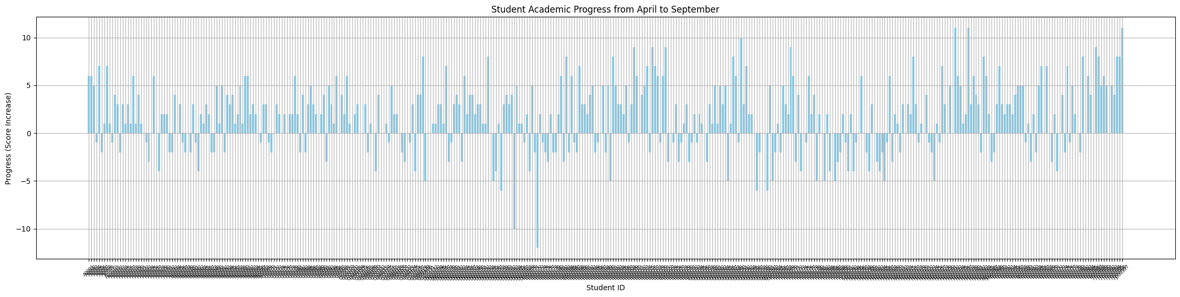
1. Perform data analysis to track each student's academic progress over time.
Notes:
Links:
https://unsplash.com/photos/fzOITuS1DIQ

Slide 3
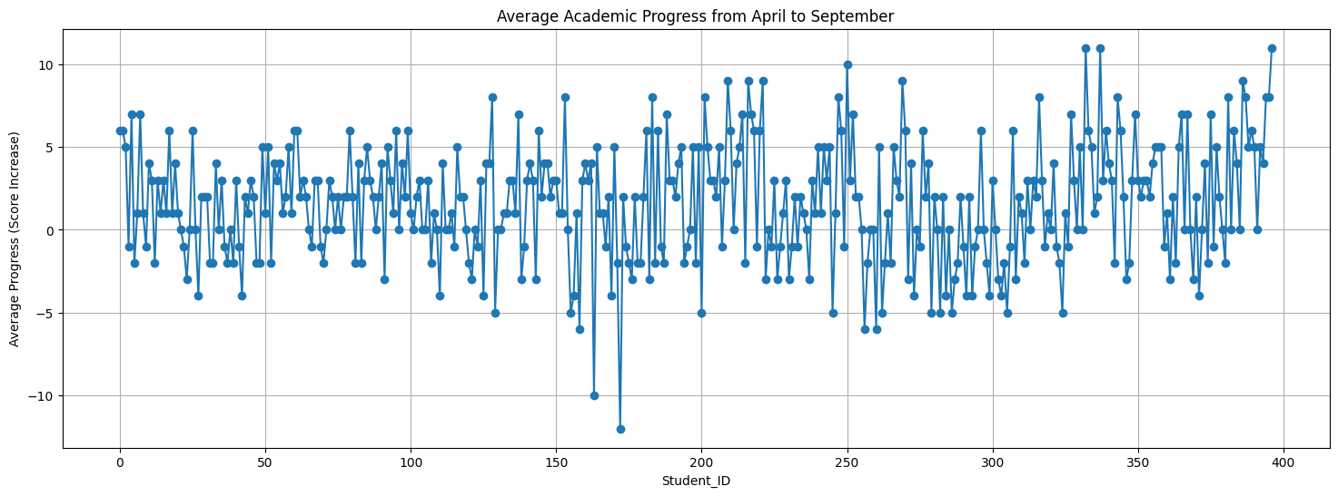
1. Perform data analysis to track each student's academic progress over time.
Notes:
Links:
https://unsplash.com/photos/fzOITuS1DIQ

Slide 4
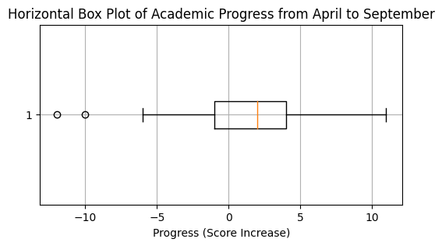
1. Perform data analysis to track each student's academic progress over time.
Notes:
Links:
https://unsplash.com/photos/fzOITuS1DIQ

Slide 5
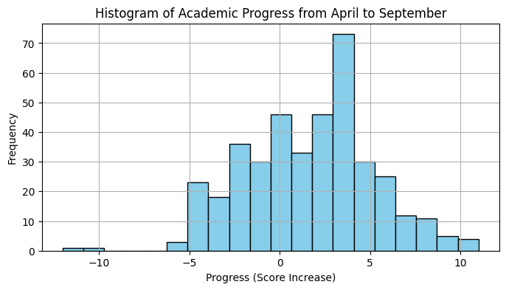
1. Perform data analysis to track each student's academic progress over time.
Notes:
Links:
https://unsplash.com/photos/fzOITuS1DIQ

Slide 6
1. Perform data analysis to track each student's academic progress over time.
Top Performing Students:
Student ID | Gender | Progress_April_to_September
H000333 | Girl | 11
H000338 | Girl | 11
J000397 | Boy | 11
G000251 | Boy | 10
E000210 | Girl | 9
Struggling Students:
Student ID | Gender | Progress_April_to_September
E000173 | Boy | -12
D000164 | Boy | -10
D000159 | Boy | -6
G000257 | Girl | -6
G000261 | Girl | -6
Notes:
Links:
https://unsplash.com/photos/fzOITuS1DIQ

Slide 7
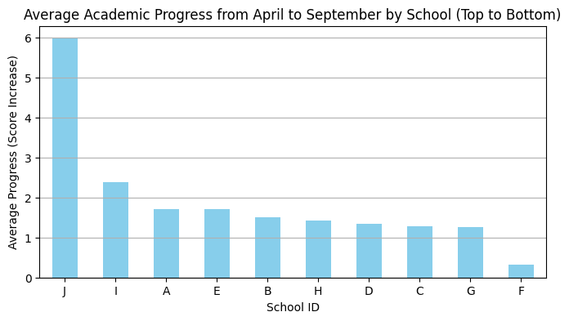
1. Perform data analysis to track each student's academic progress over time.
Notes:
Links:
https://unsplash.com/photos/fzOITuS1DIQ

Slide 8
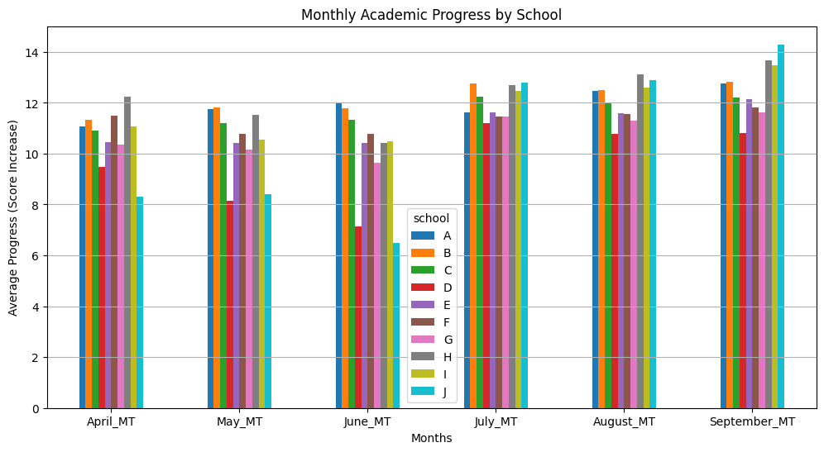
1. Perform data analysis to track each student's academic progress over time.
Notes:
Links:
https://unsplash.com/photos/fzOITuS1DIQ

Slide 9
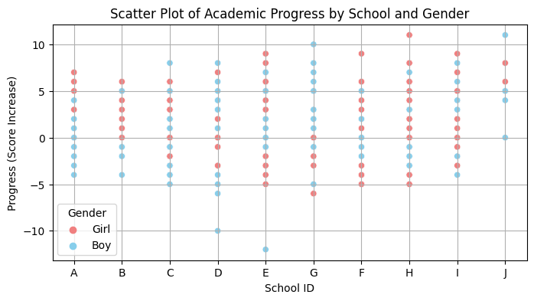
1. Perform data analysis to track each student's academic progress over time.
Notes:
Links:
https://unsplash.com/photos/fzOITuS1DIQ

Slide 10
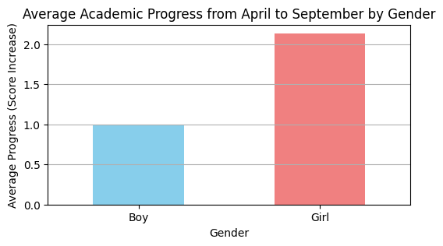
1. Perform data analysis to track each student's academic progress over time.
Notes:
Links:
https://unsplash.com/photos/fzOITuS1DIQ

Slide 11
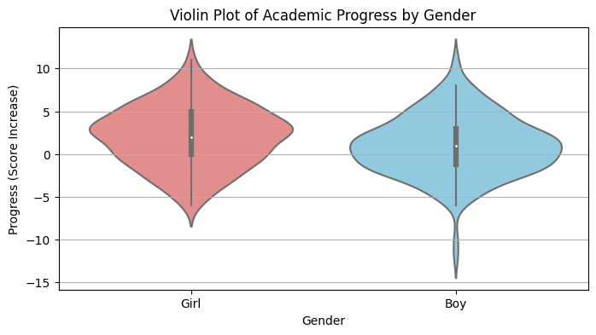
1. Perform data analysis to track each student's academic progress over time.
Notes:
Links:
https://unsplash.com/photos/fzOITuS1DIQ

Slide 12
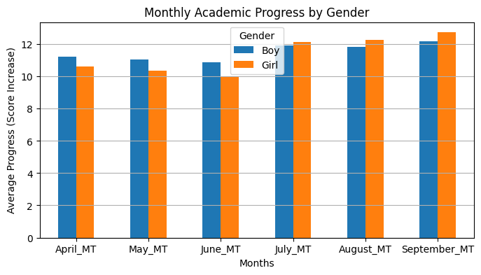
1. Perform data analysis to track each student's academic progress over time.
Notes:
Links:
https://unsplash.com/photos/fzOITuS1DIQ

Slide 13
2. Calculate applicable statistical measures for student performance at each time point.
index | count | mean | std | min | 25% | 50% | 75% | max
April_MT | 397 | 10.88 | 3.33 | 3 | 8 | 11 | 13 | 19
May_MT | 397 | 10.69 | 3.77 | 0 | 9 | 11 | 13 | 19
June_MT | 397 | 10.38 | 4.60 | 0 | 8 | 11 | 14 | 20
July_MT | 397 | 12.02 | 2.42 | 0 | 10 | 12 | 14 | 18
August_MT | 397 | 12.05 | 2.42 | 6 | 10 | 12 | 13 | 19
September_MT | 397 | 12.47 | 2.61 | 0 | 11 | 12 | 14 | 19
Average_Score | 397 | 11.41 | 2.47 | 5.83 | 9.67 | 11.33 | 13 | 18.17
Progress_April_to_September | 397 | 1.59 | 3.56 | -12 | -1 | 2 | 4 | 11
Notes:
Links:
https://unsplash.com/photos/fzOITuS1DIQ

Slide 14
2. Calculate applicable statistical measures for student performance at each time point.
index | Mean score | Median score | Mode score | Standard deviation | Variance | Skewness | Kurtosis | Coefficient of Variation (CV) | Range
April_MT | 10.88 | 11 | 10 | 3.333 | 11.11 | 0.239 | -0.7 | 0.306 | 16
May_MT | 10.69 | 11 | 9 | 3.77 | 14.22 | -0.42 | 0.583 | 0.353 | 19
June_MT | 10.38 | 11 | 10 | 4.605 | 21.21 | -0.72 | 0.362 | 0.444 | 20
July_MT | 12.02 | 12 | 11 | 2.422 | 5.868 | -0.07 | 0.918 | 0.202 | 18
August_MT | 12.05 | 12 | 12 | 2.42 | 5.857 | 0.3 | -0.17 | 0.201 | 13
September_MT | 12.47 | 12 | 11 | 2.608 | 6.8 | -0.35 | 1.547 | 0.209 | 19
Notes:
Links:
https://unsplash.com/photos/fzOITuS1DIQ

Slide 15
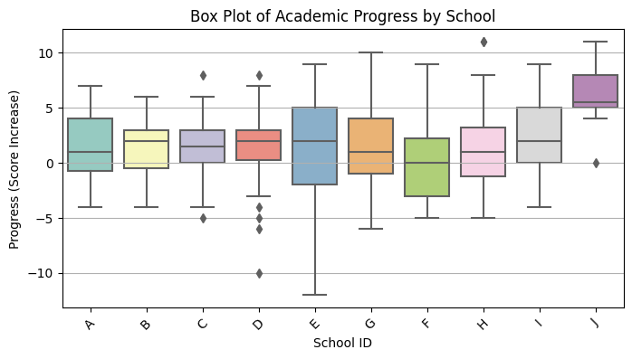
3.Create visualizations to illustrate the learning progress and trends at student or school level.
Notes:
Links:
https://unsplash.com/photos/fzOITuS1DIQ

Slide 16

3.Create visualizations to illustrate the learning progress and trends at student or school level.
Notes:
Links:
https://unsplash.com/photos/fzOITuS1DIQ

Slide 17
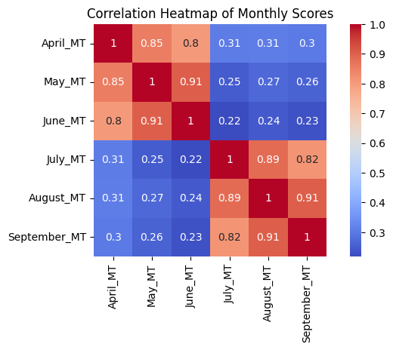
3.Create visualizations to illustrate the learning progress and trends at student or school level.
Notes:
Links:
https://unsplash.com/photos/fzOITuS1DIQ

Slide 18
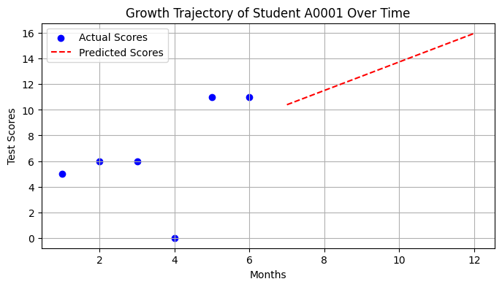
4. Apply relevant statistical tools to model the growth trajectories of students over time.
Notes:
Links:
https://unsplash.com/photos/fzOITuS1DIQ

Slide 19
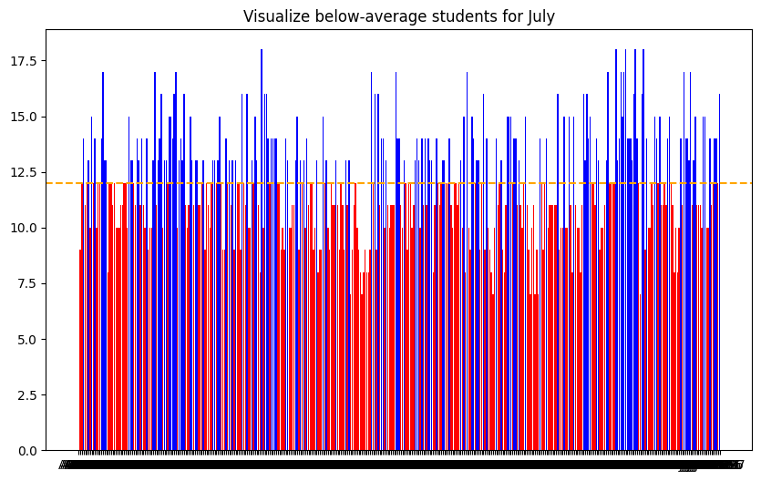
5. Generate a monthly report for July, summarizing the learning growth trends of students, along with insights and recommendations on the learning gap.
Notes:
Links:
https://unsplash.com/photos/fzOITuS1DIQ

Slide 20
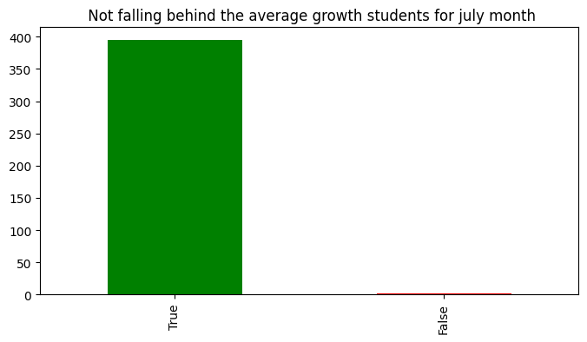
5. Generate a monthly report for July, summarizing the learning growth trends of students, along with insights and recommendations on the learning gap.
Notes:
Links:
https://unsplash.com/photos/fzOITuS1DIQ

Slide 21
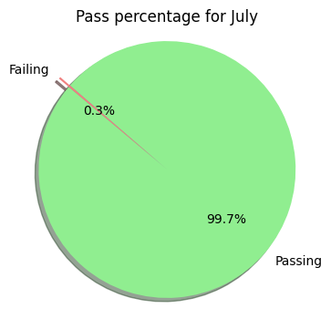
5. Generate a monthly report for July, summarizing the learning growth trends of students, along with insights and recommendations on the learning gap.
Notes:
Links:
https://unsplash.com/photos/fzOITuS1DIQ

Slide 22
Thank you
Notes:
Links:
https://unsplash.com/photos/fzOITuS1DIQ

